Slide 1
Week 1
Plotting and stuff
(log into the Jupyter server as student1, password s1)

Slide 2
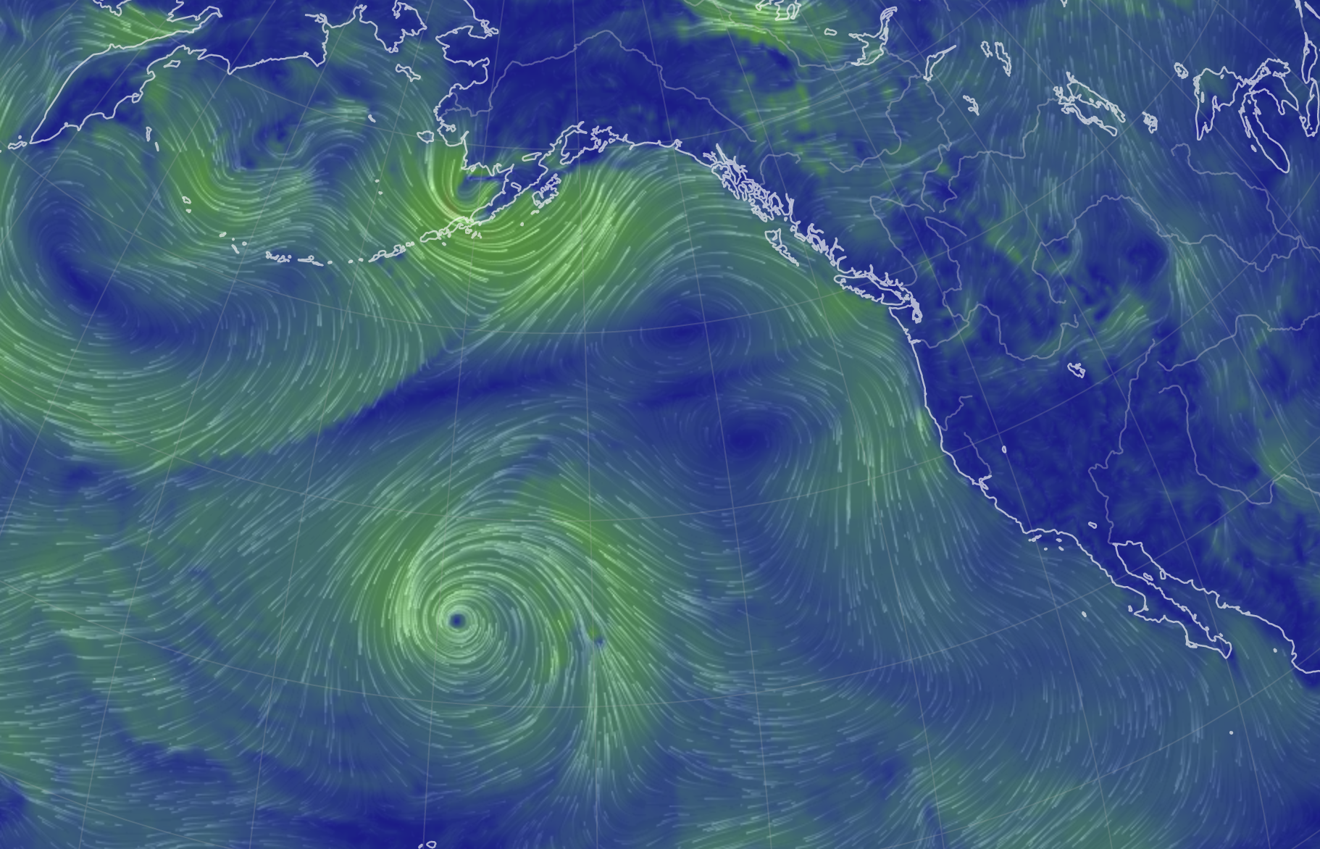
Week 1
Synoptic systems
Is this a low-pressure system or a high-pressure system?
Is it stormy and rainy here, or clear and dry?

Slide 3
Week 1
Order of operations
Which formula below gives a result that is different from the other two?
9 * 8**2 – 13
(9 * 8**2) – 13
9 * (8**2 – 13)

Slide 4
Week 2
How arrays are organized
Suppose we say
my_football_list = [25, 32, ‘hut-1', ‘hut-2', 'hike!’]
What will print in each case?
print(my_football_list[-1])
print(my_football_list[0])
print(my_football_list[3])

Slide 5
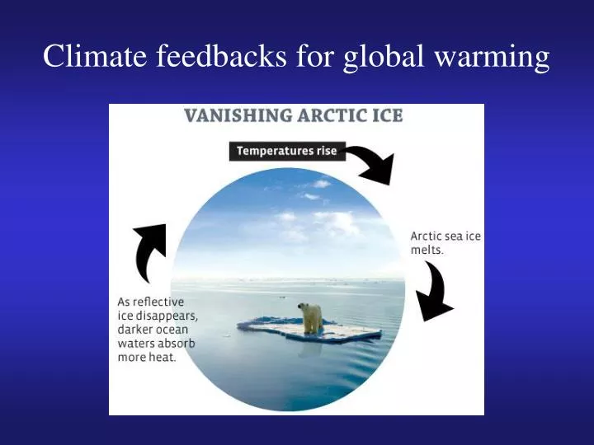
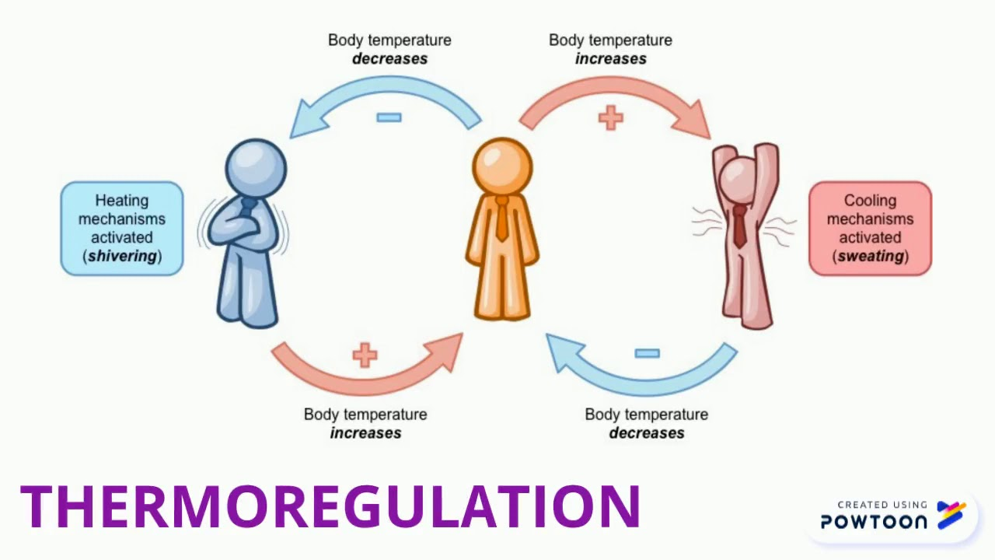

Week 2
Homeostasis vs positive feedback
Identify each cycle below as a process likely to end with homeostasis, vs a process likely result in a positive feedback.
A. Physiology
B. Climate
C. Population
(Ignoring deaths)

Slide 6
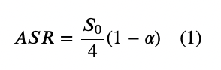
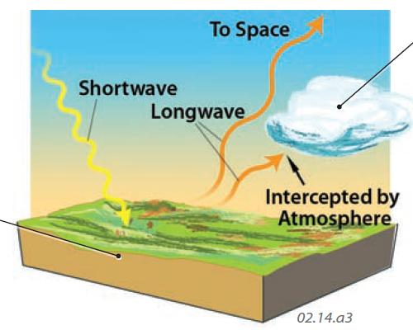

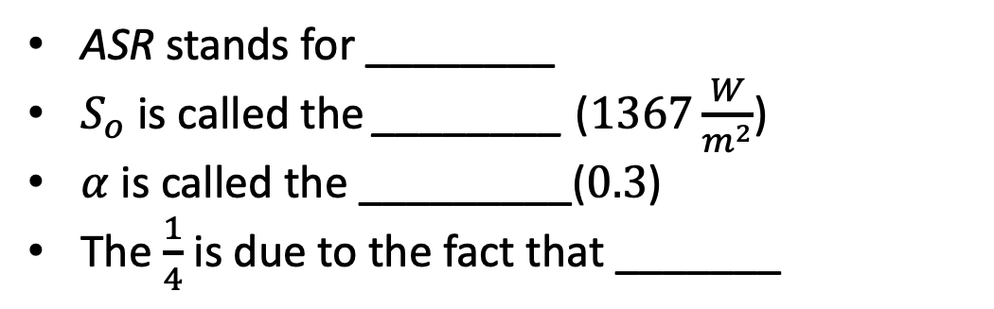
Week 2
Radiative balance
ASR stands for ________
$S_{o}$ is called the ________ ($1367\frac{W}{m^{2}}$)
$α$ is called the _________($0.3$)
The $\frac{1}{4}$ is due to the fact that _______

Slide 7
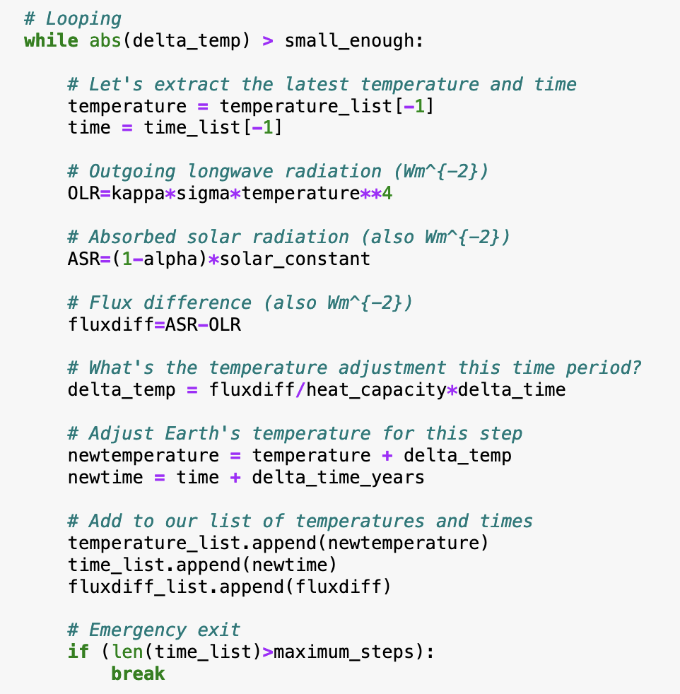
Week 2
Euler’s solution to radiative balance
There is one quantity that is calculated in the loop, that doesn't need to be in the loop, since it could easily (and more efficiently) be calculated before the loop begins. Which quantity is that?

Slide 8
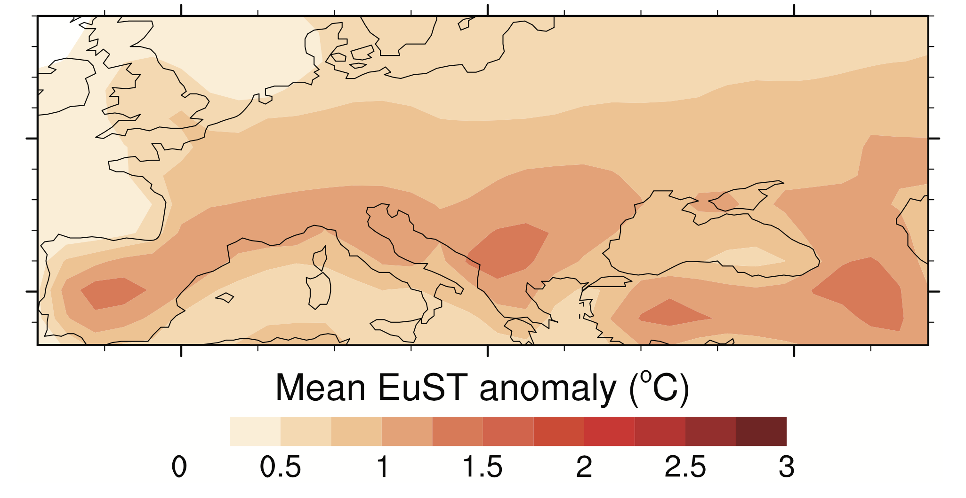
Weeks 3-4
GCM & RCP basics
What do the letters GCM stand for?
How is a temperature anomaly map different from a temperature map?
Which is the more dangerous scenario?
RCP2.6
RCP6.0
RCP8.5

Slide 9
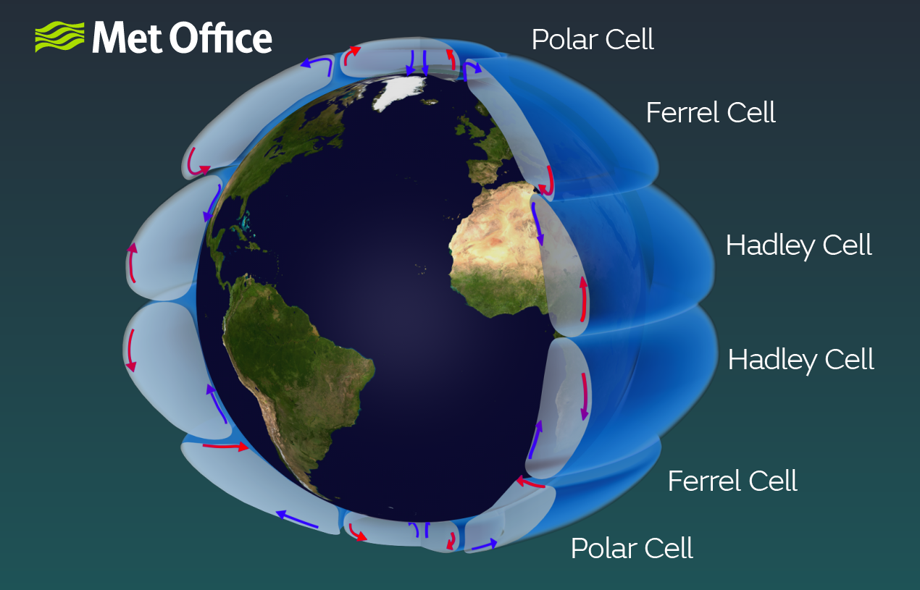






Weeks 3-4
Structure of the atmosphere, part 1
Provide the names of the cells:
____
____
____
A
B
C
C
B
A

Slide 10
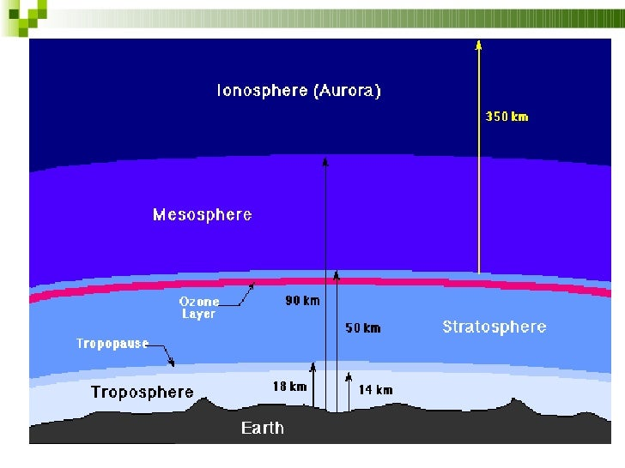

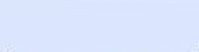
Weeks 3-4
Structure of the atmosphere, part 2
Provide the names of these layers:
____
____
A
B

Slide 11
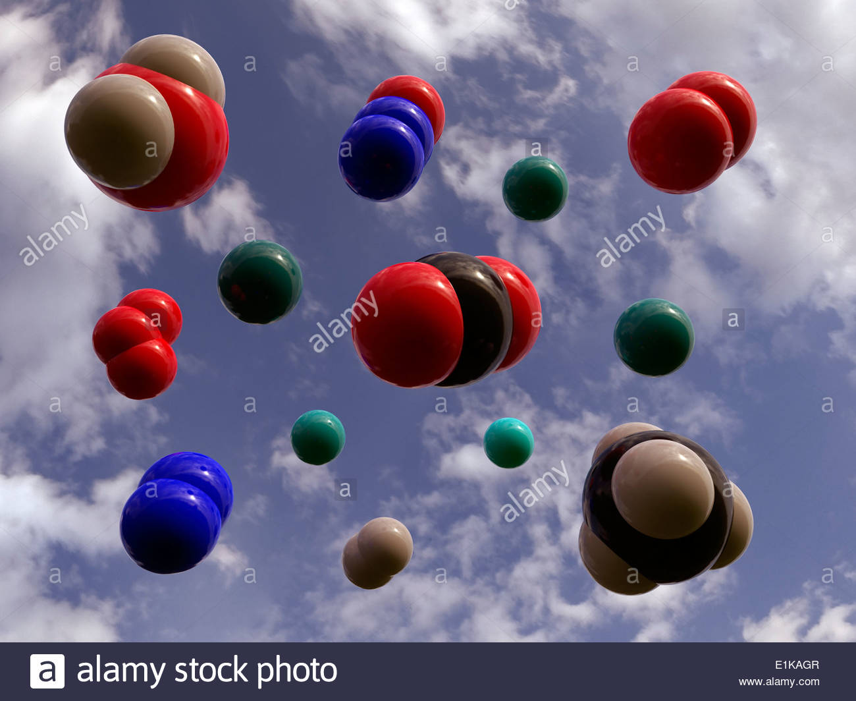
Weeks 3-4
Composition of the atmosphere
Provide the names of (or point to) these molecules:
Most abundant molecule in Earth’s atmosphere: ____
2nd most abundant molecule: ____
#1 greenhouse gas on Earth: ____
#2 greenhouse gas on Earth: ____

Slide 12
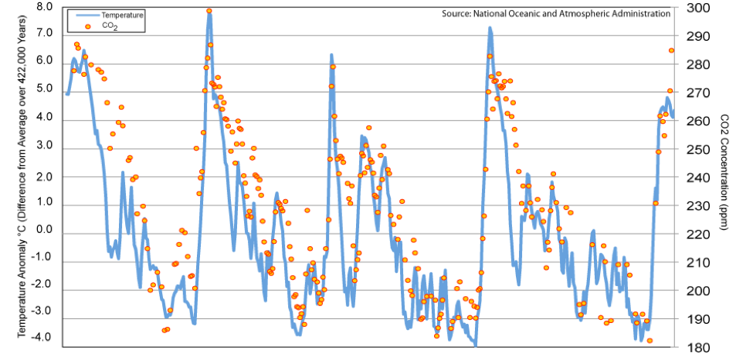
Week 5
The Pleistocene
The timing of the ups and downs in this figure is due to
El Niño/La Niña variations
Monsoons
Wobbling of Earth’s orbit
Anthropogenic CO₂ release
400,000 yr 300 ky 200 ky 100 ky Present

Slide 13
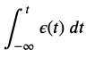
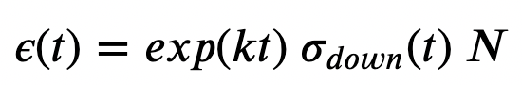
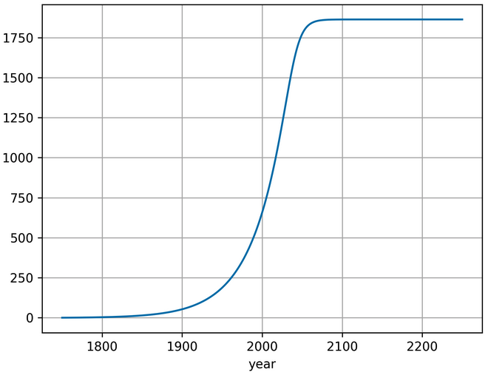
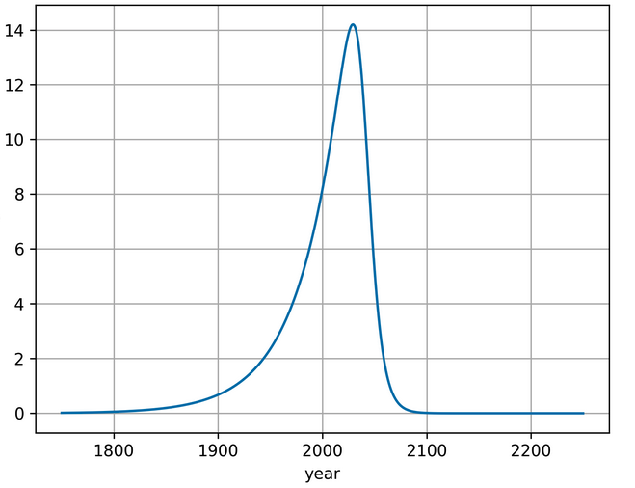
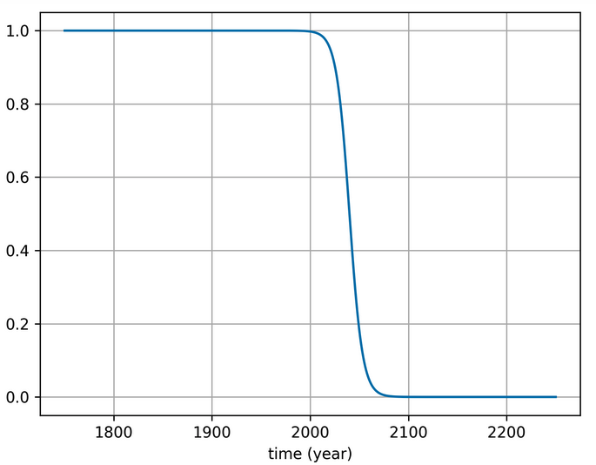
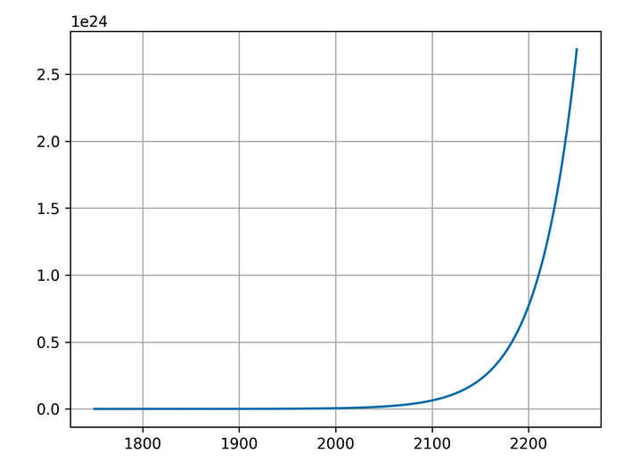
Week 5
Anthropogenic emissions
Match letters to the numbers: 1. ___ 2. ___ 3. ___ 4. ___
2
3
4
1
A
B
C
D
year
year
year
year

Slide 14
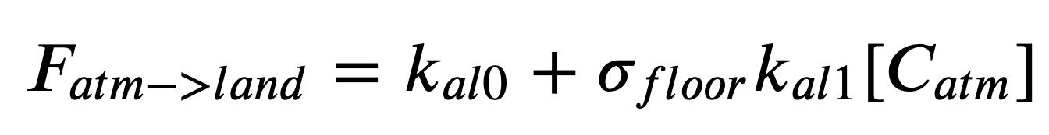
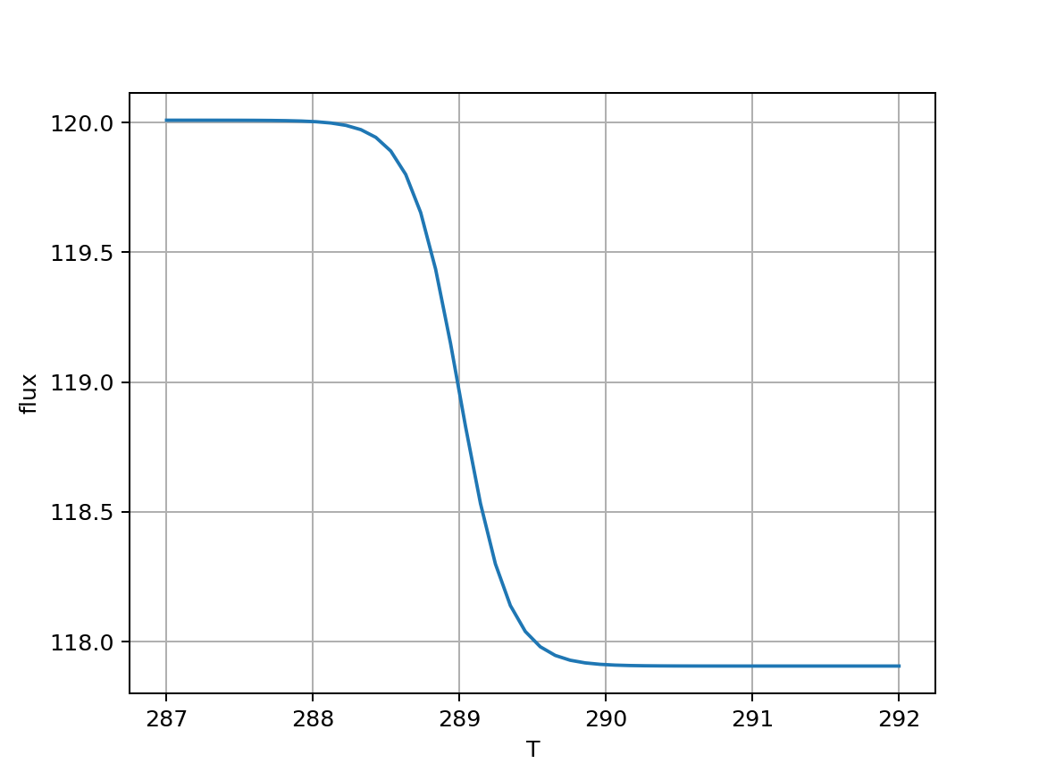
Week 5
Temperature-dependent fluxes
Identify the term in this equation that is responsible for the reduction in atmosphere-to-land carbon flux due to increasing temperature.

Slide 15
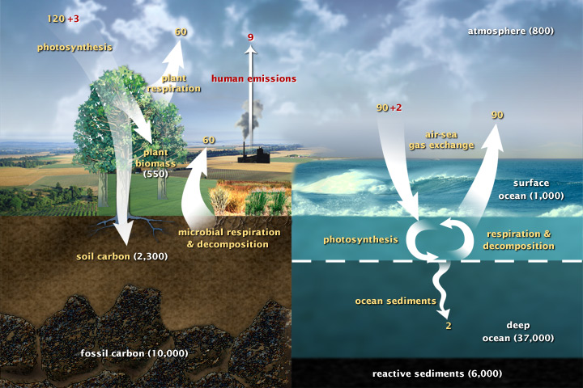
Week 5
CO₂ fertilization
One or two of the numbers in this figure is a flux that results from heightened atmospheric CO₂ due to anthropogenic emissions.
Identify which, and explain how.

Slide 16
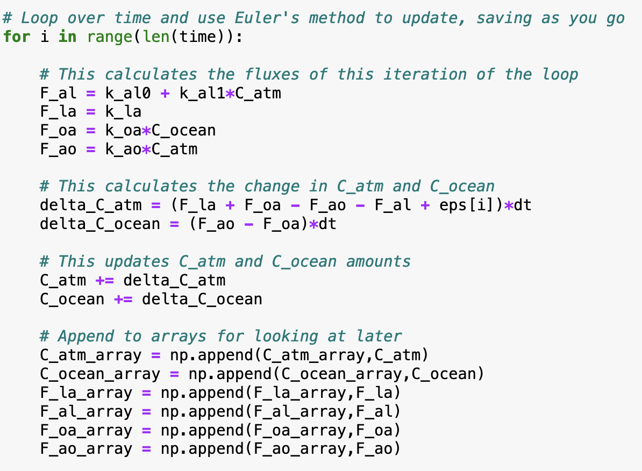
Week 6
Euler’s method
Euler’s method is most generally described as …
an algorithm for computing atmospheric fluxes
an algorithm for solving a set of coupled ordinary differential equations
a method of appending values to arrays
a generic term for looping in Python

Slide 17
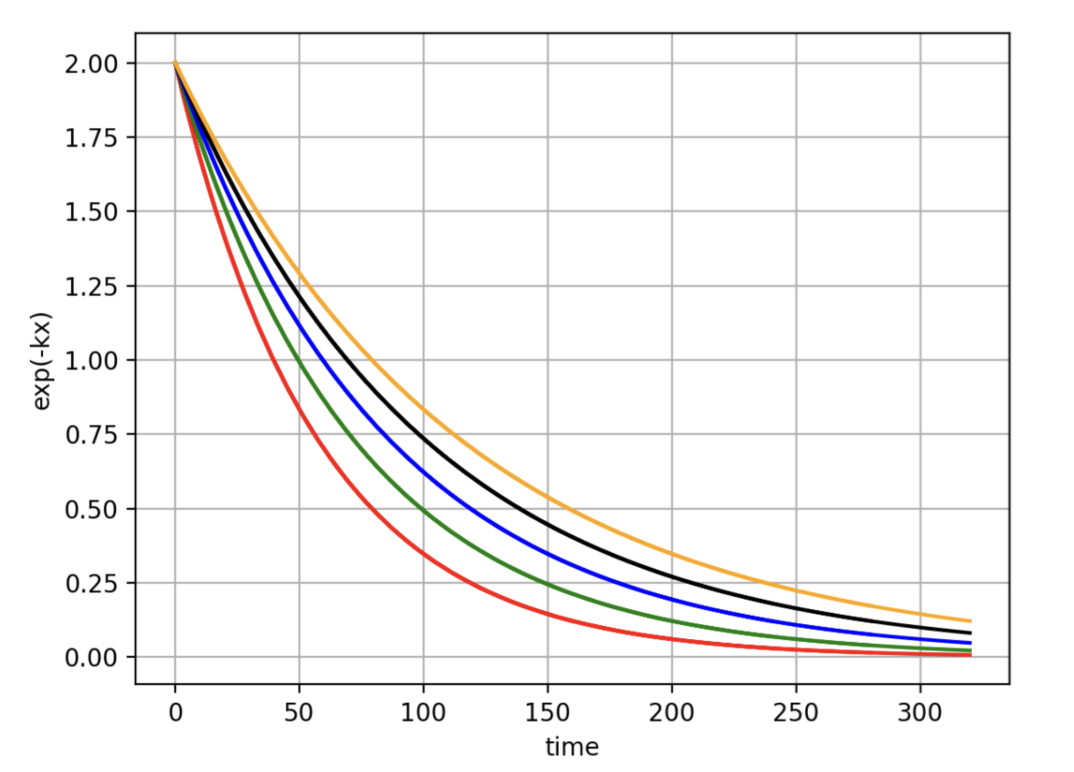
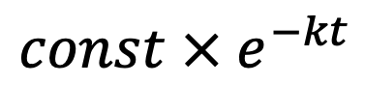
Week 6
Exponential decay and the rule of 70s
Which of these curves has $k=0.014 yr^{−1}?$
$${const × e}^{−kt}$$

Slide 18
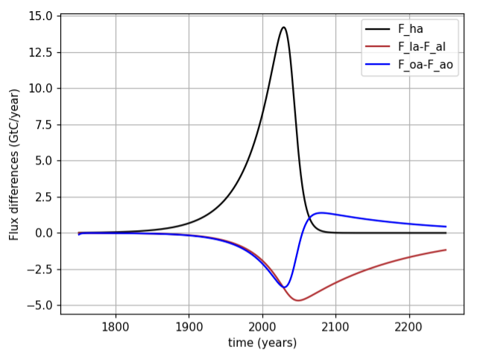
Week 6
Net fluxes, part 1
The blue curve on the left represents the difference between which two terms in the figure on the right?
C ↑
D ↓
E ↑
A↓
B↑
F ↓

Slide 19
Week 6
Net fluxes, part 2
Approximately what percentage of anthropogenic emissions have been getting absorbed by land up till the present day (say, year 2000)?
C ↑
D ↓
E ↑
A↓
B↑
F ↓

